Slide 1
SOFTWARE PROCESSES

Slide 2
GENERIC SOFTWARE PROCESS MODELS
The waterfall model
  Separate and distinct phases of specification and development.
Incremental development
  Specification, development and validation are interleaved. May be plan-driven or agile
Reuse-oriented software engineering
  The system is assembled from existing components. May be plan-driven or agile.

Slide 3
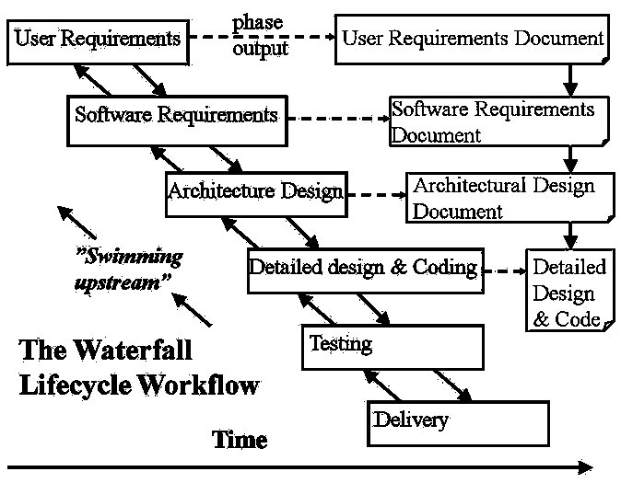
THE WATERFALL MODEL
Notes:
The waterfall model is the classic lifecycle model – it is widely known, understood and (commonly?) used.
In some respect, waterfall is the ”common sense” approach.
Introduced by Royce 1970.
SE is about process, what are the steps that people take to develop software and the process that we will be covering in class will be XP.
Here we have slides about the traditional software development process (the first one that was documented) known as waterfall.
When you try and visualize this it tries to describe how software development is done in the form of steps
Requirements: Figure out what your software should do. E.g Powerpoint, we want a software that allows us to make slides and give presentations. Ofcourse that is very high-level so we need to break that down and do refinement.
Design: Figure out how you will satisfy these requirements, organize your code, what are the modules that you are going to have, what classes are you going to use if you are in java, packages, methods. Usually this can be split up into high-level design and low-level design. Usually you have a high-level architecture for the entire system and smaller ones for the modules.
Implementation: You have the name of the classes and methods now you go and implement the bodies.
Integration: In design you split the modules, and different groups implement those modules. Integration tells you how to put these things together.
Maintenance: Once you are done with integration you can release and start selling your software earning a lot of money. If you are utube you can sell yourself to google for 4 million dollars and then give maintenance to someone else because you have enough to retire.
The way waterfall was originally described was without the back edges. So you froze each of your artifacts after each stage. In practice its very hard to freeze the requirements and never ever go back cause they are constantly changing. So waterfall was fixed to be iterative in the sense that once you do the requirements and start the design, you cycle back and start refining the requirements. Similarly once you started coding you may feel that the design has shortcomings and go and refine that.
So waterfall without the back edges is purely theoretical somethings which we teach only in classes and rarely followed in practise unless in very special cases where the requirements are very stable and they never change e.g defense contractors, making some software to deliver some rockets where things can be fixed especially if they tell you that you have 2 years to deliver the software.
In contrast what XP does is reverses the picture the other way around starting with testing.
Unlike other engineers (e.g. civil, electronic, chemical … etc.) software engineers do not produce anything physical.
It is inherently difficult to monitor an SE project due to lack of visibility.

Slide 4
ADVANTAGES
Easy to understand and implement.
Widely used and known (in theory!)
Reinforces good habits: define-before- design, design-before-code
Identifies deliverables and milestones
Document driven, URD, SRD, … etc. Published documentation standards, e.g. PSS-05.
Works well on mature products and weak teams.

Slide 5
DISADVANTAGES I
Idealised, doesn’t match reality well.
Doesn’t reflect iterative nature of exploratory development.
Unrealistic to expect accurate requirements so early in project
Software is delivered late in project, delays discovery of serious errors.

Slide 6
DISADVANTAGES II
5. Difficult to integrate risk management
Difficult and expensive to make changes to documents, ”swimming upstream”.
Significant administrative overhead,
costly for small teams and projects.

Slide 7
INCREMENTAL DEVELOPMENT
  Objective is to work with customers and to evolve a final system from an initial outline specification. Should start with well-understood requirements and add new features as proposed by the customer.(Create different versions)
    Reduce cost
    Easy to get customer feedback
    Rapid delivery & deployment of software
Throw-away prototyping
  Objective is to understand the system requirements. Should start with poorly understood requirements to clarify what is really needed.

Slide 8
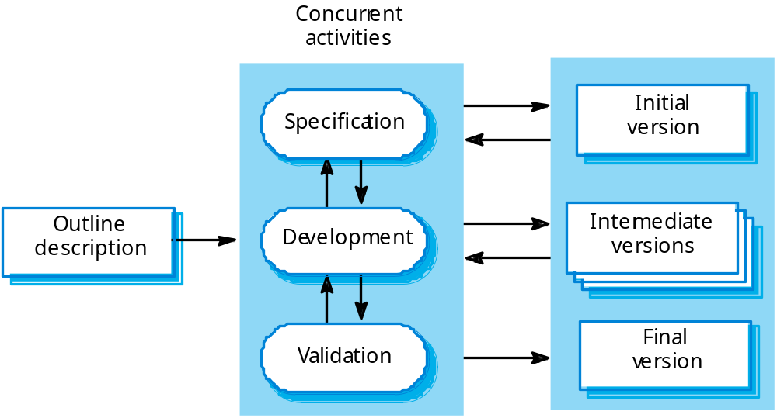
INCREMENTAL DEVELOPMENT
CHAPTER 2 SOFTWARE PROCESSES

Slide 9
INCREMENTAL DEVELOPMENT
Problems
  Lack of process visibility;
  Systems are often poorly structured;
  Special skills (e.g. in languages for rapid prototyping) may be required.
Applicability
  For small or medium-size interactive systems;
  For parts of large systems (e.g. the user interface);
  For short-lifetime systems.

Slide 10
REUSE-ORIENTED DEVELOPMENT
Based on systematic reuse where systems are integrated from existing components or COTS (Commercial-off-the-shelf) systems.
Process stages
  Component analysis;
  Requirements modification;
  System design with reuse;
  Development and integration.
This approach is becoming increasingly used as component standards have emerged.
  e.g. using databases, spread sheets, word proccessors, graphics software, web browsers, etc.

Slide 11
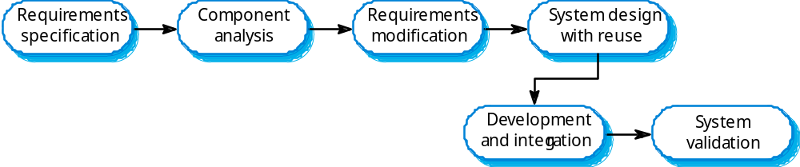
REUSE-ORIENTED DEVELOPMENT

Slide 12
REUSE-ORIENTED DEVELOPMENT
Advantages
Fast, cheap solution
May give all the basic functionality
Well defined project, easy to run
Disadvantages
Limited functionality
Licensing problems, freeware, shareware, etc.
License fees, maintainance fees, upgrade
compatibility problems

Slide 13
CODE-AND-FIX
This model starts with an informal general product idea and just develops code until a product is ”ready” (or money or time runs out). Work is in random order.
Used for short system that do not require maintenance
Corresponds to no plan! (Hacking!)

Slide 14
CODE-AND-FIX DISCUSSION
Pros
  No administrative overhead
  Signs of progress (code) early.
  Low expertise, anyone can use it!
  Useful for small “proof of concept” projects, e.g. as part of risk reduction.
Cons
  No visibility/control, No resource planning
  No deadlines, Mistakes hard to detect/correct
  Impossible for large projects, communication breakdown.

